Slide 1
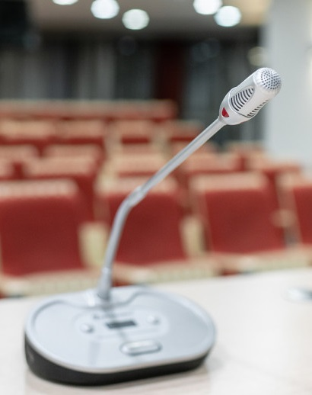
Privacy and recording notice
Please note: this <<lecture/tutorial>> will be recorded.
The recording will be made available to students enrolled in this course via the course Wattle site, after the class.
Students may ask questions and make comments by <<e.g. in person, using chat or other functions if class is conducted online>>.
If you do not wish for your question or comment to be recorded, please contact <<lecturer/tutor>>, after the class.

