Slide 1
ANU Australia Awards
  Pre-departure Guide 2025
TEQSA Provider ID: PRV12002 (Australian University)

Slide 2

Contents
Welcome | 03
Our Teams | 04
Student Responsibilities | 04
Key Dates | 05
Pre-Departure Checklist | 06
Entering Australia | 07
Arriving at ANU | 08
Accommodation at ANU | 09
Cost of Living in Canberra | 14
School Aged Children | 15
Life at ANU | 16
About Canberra | 18
Useful Links and Resources | 18
TEQSA Provider ID: PRV12002 (Australian University)

Slide 3
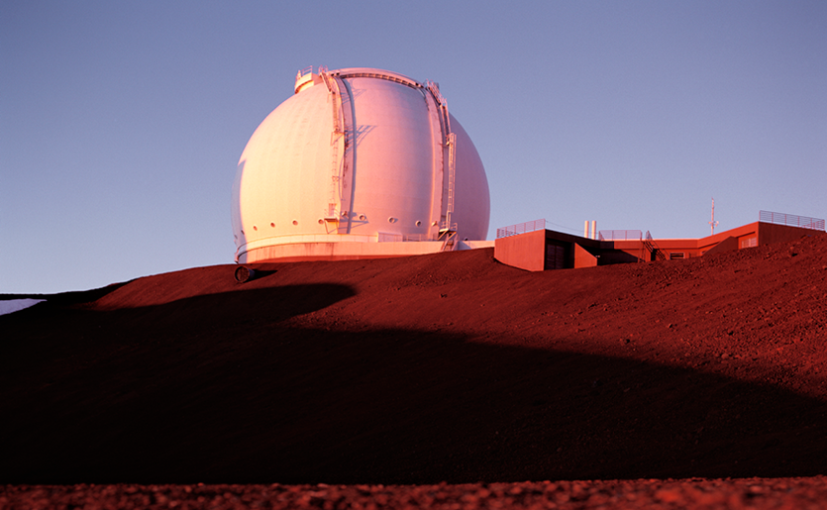
Hello & welcome!
Congratulations on receiving an Australia Awards Scholarship (AAS) and for choosing to study at The Australian National University (ANU). We hope that your education will be rewarding and your experiences with us are memorable.
ANU has two dedicated Australia Awards Management teams who provide academic and welfare support for AAS students. The type of support we provide includes:
Meeting students at the airport on arrival
Providing an extended academic and welfare orientation
Support you in adjusting to your life at the ANU and in Canberra
Arranging additional tutorial assistance
Helping you to find accommodation and arrange travel
Guidance for students with dependents
We hope that our services benefit all AAS students while on scholarship at the ANU and provide you with a greater opportunity to perform well and succeed in your studies, particularly during your first year in Canberra.
TEQSA Provider ID: PRV12002 (Australian University)

Slide 4

Our Teams
Student Responsibilities
CENTRAL AUSTRALIA AWARDS TEAM
Student Life, University Experience Di Riddell Student Centre, Building 154, University Ave, Acton, ACT, 2601 AUSTRALIA Opening hours: Monday - Friday 9am - 5pm (AEST) Telephone: +61 2 6125 1875 Email: Australia.Awards@anu.edu.au
CRAWFORD SCHOOL AUSTRALIA AWARDS TEAM
Crawford School of Public Policy ANU College of Asia and the Pacific J. G. Crawford Building 32 Lennox Crossing, Acton, ACT, 2601 AUSTRALIA Opening hours: Monday - Friday, 9am - 5pm (AEST) Telephone: +61 2 6125 0556 +61 2 6125 2539 Email: Lam.Hua@anu.edu.au
We want you to have the best time while you’re in Australia. It’s very important that you remember your responsibilities as an AAS student so that everything runs smoothly for you and your experience with us is stress-free. As an AAS student, you must comply with all ANU, Australian Government, Department of Foreign Affairs and Trade (DFAT) and your home organisation’s rules and requirements around your study and scholarship. The responsibilities listed below are in addition to any others specified in the contract you sign with DFAT, and those outlined in the Scholarships Handbook
Remain an enrolled full-time student and satisfy all course requirements Remain in your original course Complete progress reports as requested Adhere to all conditions of your visa and ensure it is valid at all times Work only as permitted by your visa Update ISIS with any changes of address Advise AAS Management teams of any changes to bank details | Notify the AAS Management team if your family arrive in or depart from Australia Notify the AAS Management teams if you are leaving Australia during your scholarship Advise the AAS Management teams of any matter that is likely to affect your ability to complete by your award end date Depart Australia within 30 days of result release or thesis submission date. This may be before your award or visa end date
TEQSA Provider ID: PRV12002 (Australian University)

Slide 5


Key Dates 2025
Semesters & Sessions Summer Session: 1 Jan-31 Mar Semester 1: 17 Feb-23 May Autumn Session: 1 Apr-30 Jun Winter Session: 1 Jul-30 Sep Semester 2: 21 Jul-24 Oct Spring Session: 1 Oct-31 Dec Census Dates: Semester 1 – 31st March Semester 2 – 31st August Non-standard sessions: please consult Programs & Courses for your non-standard session course for census dates, Examination Periods Semester 1 Final: 29 May-14 Jun Semester 2 Final: 30 Oct-15 Nov Teaching Breaks Semester 1: 31 Mar-14 Apr Mid-Year: 23 May-21 Jul Semester 2: 1 Sep-15 Sep Grades Release Semester 1: 26 June Semester 2: 27 Nov | Graduation Dates March 31 – 4 April Public Holidays New Years Day: 1 Jan Australia Day: 26 Jan Canberra Day: 10 Mar Good Friday: 18 Apr Easter Monday: 21 Apr ANZAC Day: 25 Apr Reconciliation Day: 2 Jun King’s Birthday: 9 Jun Labour Day: 6 Oct Christmas Day: 25 Dec Boxing Day: 26 Dec
TEQSA Provider ID: PRV12002 (Australian University)

Slide 6
Pre-Departure Checklist
Accommodation and Arrival
Apply for on-campus accommodation
Confirm airport pickup and arrival details
Organise temporary accommodation if needed
Documentation
Send to ANU:
    Completed and Signed Offer Letter and Acceptance Declaration
    Temporary accommodation form (if needed)
    Colour copy of current passport and visa
Please bring with you to Australia:
    ANU letter of offer
    Certified copies of Academic transcripts
    References (work, previous landlords, personal references all may be useful)
    Documents relating to existing health conditions
    Copy of passport, visa details and credit cards to keep in luggage
    Drivers licence if you intend to drive in Canberra (including certified translation if not in English)
Health
Complete dental and optical check-ups at home – these are not covered by Overseas Student Health Cover (OSHC)
Bring prescribed medications and prescriptions
Bring an extra pair of glasses/spare contact lenses
Register all chronic medical conditions requiring ongoing treatment with ANU Medical Centre and ANU Accessibility who can assist with making reasonable adjustments for you to complete your study at ANU.
Other Essentials
Enough funds to cover accommodation and daily expenses until you receive your establishment fee and stipend
Linen
    On-campus accommodation may provide temporary use of a linen pack on arrival. But check in advance in case you need to bring linen with you
    Off-campus accommodation you will need to provide your own linen
If arriving between May to September, bring sufficient cold and wet weather clothing. Temperature overnight can be below zero!
Please ensure you have an adapter for your electronic devices, so you can use them in Australia
TEQSA Provider ID: PRV12002 (Australian University)

Slide 7

Entering Australia
There are important things you should know about travelling to Australia. The Department of Home Affairs is responsible for maintaining Australia’s bio-security. People, animals and items travelling into the country are subject to requirements, which extend to mailing items to Australia and online shopping purchases.
Quarantine
The airline will provide you with an Incoming Passenger Card and you must complete it truthfully. This is a legal document.
Declare certain food, plant material, wooden items and animal products on your Incoming Passenger Card
Items declared will be inspected to ensure they are safe
If bio-security concerns or pest/diseases are found, products may require treatment (at your cost) such as fumigation or irradiation
Unsafe items that can’t be treated will be seized and destroyed
You will not be penalised for declaring items, even if they are not allowed to enter Australia. If in doubt, ask an officer on duty for advice. You can dispose of items at bins in the terminal if you don’t want to declare them
See Can I bring it in? (homeaffairs.gov.au) for more information about what you can bring in to Australia and biosecurity requirements.
International Mail and Cargo
All letters and packages are screened by quarantine to check they don’t contain prohibited items. Ensure your family don’t send you prohibited items
Cargo sent by freight may need an import permit or treatment before being released. Packing materials and containers made with straw or egg, fruit and vegetable cartons are prohibited due to biosecurity risk.
TEQSA Provider ID: PRV12002 (Australian University)

Slide 8

Arriving at ANU
Airport Pickup
If you have provided the AAS Teams with your airport pickup and temporary accommodation form, detailing your arrival information, you will be picked up at the airport.
If you miss your flight or have delays, contact the Australia Awards teams using the contact details on Page 4 (Mon-Fri 9am-5pm).
Transiting in Another State
Please review the information at the links below on how to transfer to the domestic terminals at the major hubs:
    Sydney
    Melbourne
    Brisbane
  Important Note: All passengers arriving from an international port will need to go through passport control, collect their luggage and pass through Customs and Quarantine before transferring to the Domestic Terminal. This applies even if you have a ticket for onward travel.
Money
Please ensure you have at least AUD800 cash when you arrive in Australia to buy your meals and essentials for the first few days. There is a 24-hour currency exchange ATM at the airport and branches in the city. Most banks are open Monday to Friday only. Do not leave Canberra airport with only foreign currency.
If you intend to transfer money from overseas or exchange currency, check the rates that the different banks offer. Some banks may even offer students a discount if you present your student card.
Accompanied Students
The Australian Government and the ANU are unable to offer financial or other support for your dependents (partner, children etc.) during your studies in Australia.
It is strongly advised that students do not bring their family immediately to Australia with them. We recommend waiting a full semester, as this gives you a chance to adjust to life in Australia, keep up with your studies and find suitable accommodation – without the pressure of looking after family also.
The Introductory Academic Program (IAP) sessions will guide you on how to upgrade your OSHC, find schooling and secure long-term accommodation off campus for you and your family.
Visa and OSHC payments must be made upfront for the full duration of your family members stay in Australia. This is a significant cost and another reason that it is best if you do not bring your family immediately.
TEQSA Provider ID: PRV12002 (Australian University)

Slide 9
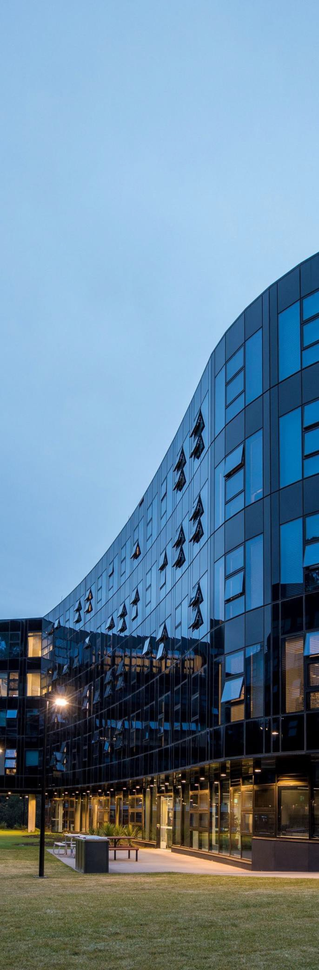
Accommodation
Temporary Accommodation
Temporary accommodation can be arranged, upon request, for unaccompanied students for the first few weeks of the IAP. The costs for temporary accommodation will need to be covered in full by the student.
If you no longer require temporary accommodation upon arrival in Australia, you must advise our office no later than 15 days prior to your arrival. If you do not provide this advice, you will be responsible for all associated costs of the temporary accommodation.
On-campus Accommodation
On-campus accommodation will be available for unaccompanied students upon application. You must apply for on-campus accommodation as soon as possible. Apply Here!
Demand for on-campus accommodation is extremely high and it’s possible not everyone will be offered a place. Applications for residing on-campus are governed by University Accommodation Services (UAS) and information and the online registration form can be found here.
Most residential halls are fully furnished, but you should check if you are required to provide your own bed linen and/or cooking utensils, cutlery and crockery.
ANU offers students a choice of accommodation including catered and self-catered. Read more about our residences here.
TEQSA Provider ID: PRV12002 (Australian University)

Slide 10
Accommodation Costs
Weekly rental prices for accommodation on-campus start from approximately $276. For more details on residence fees and charges, please visit our cost comparison page.
You must also remember to budget for other living expenses (cleaning, laundry, utilities etc.) as well as meals, transport, textbooks and entertainment expenses. Read more about the cost of living in Canberra here.
How to Apply
Students may apply for on-campus accommodation via the accommodation portal Apply Here!
Once you have been made an offer, you will be asked to pay an acceptance fee to secure your room. This fee amount varies between individual Halls and Colleges and usually includes two weeks of rent in advance, registration fee, residential community fee and a refundable deposit.
Please consider your initial preferences carefully. It is difficult to change your preferences and, if you do so, you may return to the bottom of the wait-list for your new preference accommodation. Once you have accepted the offer and paid you fee, you are liable for all fees for the entire contract period!
Off-Campus & Family Accommodation
On-campus accommodation is mainly available for students only, with a few rooms suitable for couples. This means that couples and families will need to find a house or flat to rent off campus. Single students may also prefer to seek off-campus accommodation for privacy, or to save on costs by sharing with other students.
Rental properties are in short supply and high demand in Canberra – time and perseverance is needed to secure suitable accommodation. If you are not single, you are strongly advised to arrive in Canberra alone and have your family join you later. There are very important reasons for this. Firstly, short-term accommodation suitable for families is limited to hotels, which are usually very expensive. Secondly, the most suitable long-term accommodation for families is an apartment or house and you should never arrange to rent these without first inspecting the property.
Rental Options
Off-campus rental can come in different forms:
    Renting a home for yourself (and family if they accompany you)
    Sharing a rental property with one or more unrelated people
    Boarding – renting a room with a local family. The boarding fee may include meals/utilities.
  Shared accommodation is a great starting point for single students new to Canberra as this can make renting off-campus more affordable. The benefits of a group house could include security, shared expenses and responsibilities, and making new friendships. However, you need to consider the lack of privacy, personality clashes and social distractions that may affect your study.
TEQSA Provider ID: PRV12002 (Australian University)

Slide 11
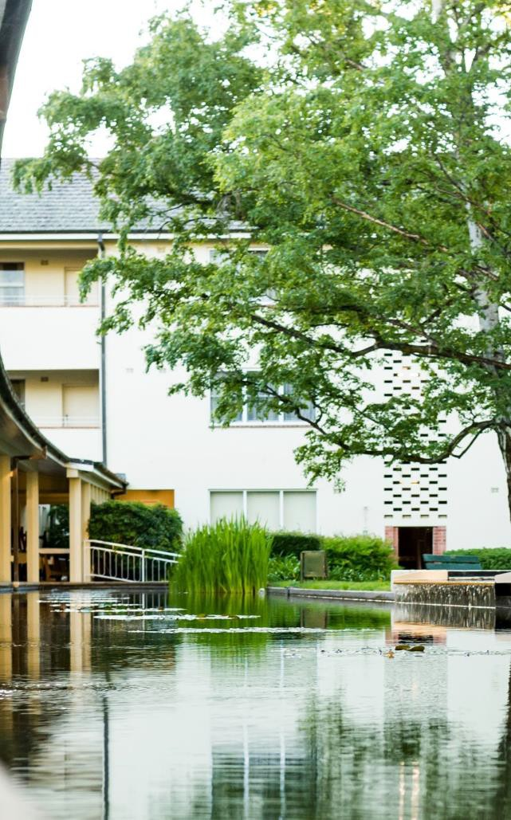
Rental Costs
Rental prices can vary from $450-$600 AUD per week or even more for unfurnished apartments or small houses in Canberra. Rentals around the outer suburbs or Queanbeyan (a town on the border of Canberra) are generally slightly lower – perhaps starting at around $350-$450 AUD per week.
You will need to consider other upfront set-up costs such as rental bond (refundable at end of lease if property is left and appropriate condition), establishing utilities, purchasing furniture. You can visit our Cost of Living page for examples on what you should expect to spend on establishment.
Finding Rentals
Don’t expect to find something on the first day you start looking. Depending on the time of year you arrive, it can take weeks and sometimes even months to secure accommodation. The beginning of the year is usually the most difficult time. You need to be proactive and take the initiative to go out and search!
We suggest you start looking at rental listings even before you depart your home country, so you can get a better understanding of rental prices, locations and availability. However, landlords rarely advertise more than one month prior to available occupancy date.
ANU Housing Online is a free service provided by the University Accommodation Services to assist the student and staff community find rental accommodation. Listings may include whole houses/apartments or shared houses. ANU only provides the listings, You will need to deal directly with the person offering the accommodation. Visit Housing Online for more information.
You can also search for rental properties at the following websites:
Applying for Rentals
Once you have made a list of the rental properties you are interested in you should contact each Real Estate agent or landlord to make an appointment to view the property. Your Australia Awards management team can also assist by providing you with a rental reference if you are new to Australia.
Be prepared with any questions you may have about the property. Including
What is the address?
Is it close to transport/shops?
Does it come with appliances or other furnishings?
How long is the lease agreement?
Will the landlord consider groups?
Is water included in the rent?
Is the property connected to gas for cooking/heating?
What type of heating is available?
Is there a garage or space for car?
What are the total upfront costs to secure the property (bond, advance rent)?
When is the property available?
If there is an issue who do I contact, and what maintenance is covered?
Many applications will now need to be submitted online. Make sure you have your application documents ready to submit if you are interested in the property. You will need identity documents, proof of finances and references.
Don’t be afraid to include other documents that you may think will be helpful.
Rental and personal references that can be verified locally will also be of assistance. This can include friends, employer, supervisor and previous landlords.
Keep in touch with the agents to see how your application is progressing.
    All Homes
    Domain
    Real Estate
TEQSA Provider ID: PRV12002 (Australian University)

Slide 12
If you are successful in your application, you will need to sign a Tenancy Agreement with the landlord. Make sure that you read the agreement carefully and understand all of its terms and conditions.
You will have to pay a bond when signing the tenancy agreement. The bond must be lodged with the ACT Office of Rental Bonds, where it is held until you vacate the property. If there are any problems at the final inspection, the bond will be held until the issue has been rectified.
You should also receive an Inventory and Condition Report (ICR). This report outlines the condition of the property, and any furnishings and equipment attached to the premises. The agent will give you at least 2 copies of this report. You should check these very carefully and note any discrepancies on all copies. The report must be returned to the agent within 7 days of moving in. A copy will then be lodged with the Office of the Rental Bonds with your bond.
An agent or landlord may conduct an inspection of the property in the first 4 weeks and then twice within a 12-month period to check the condition of the property. You must be given seven days’ notice in writing before the inspection.
Please note that the Tenancy Agreement is a legally binding contract. If agreements are broken in circumstances other than stipulated, you may be required to pay costs related to the re-letting of the property.
You can find more information and advice at our Renting page.
The ACT Tenants’ Union provides comprehensive information on renting in Canberra and it is essential to familiarise yourself with this information before you sign a rental lease. They also provide free confidential legal advice to tenants.
The ANU Students’ Association (ANUSA) also provides free legal advice for students.
Location and Transport
The location of the property can be a major factor in the rental price. Generally, you can expect to pay less rent if living farther away from campus. However, you will need to factor in travel time and transport costs.
ANU is situated in Acton, near Civic (the city centre). Nearby suburbs within walking/cycling distance (0-5km) to ANU include: Turner, O’Connor, Braddon, Ainslie, Reid, and Campbell. These suburbs are often more expensive than the outer suburbs.
The outer suburbs are located around Dickson, Belconnen, Gungahlin and Woden. These areas have their own town centres for shopping, bus stations and other facilities.
Some of our students with large families also consider living in Queanbeyan or Tuggeranong, which are some distance away from campus but are more affordable for families. Students with children will also need to consider location in terms of school or child care needs and availability.
Canberra has an extensive network of cycle paths and on-road cycling routes. Further information can be found on the ANU cycling page.
Public Transport
Public transport in Canberra is very accessible and reliable in most areas. Check if your rental property is located near a bus stop or tram station and the frequency of transport to campus.
Rapid bus services run from Civic to Belconnen every 5 minutes on weekdays and 15 minutes on weekends. This trip takes 15 minutes.
A light rail network connects Gungahlin to Civic and runs every 6 minutes in peak and 10 minutes in off-peak. It takes approximately 20 minutes to reach Civic. From Civic it is less than 10-minute walk to ANU.
Visit the Transport Canberra (TC) website for bus fares, routes and timetables. TC uses “MyWay” as a pre-paid ticketing system. You may purchase MyWay cards at recharge facilities and if you show your student card, you may receive discounted fares.
TEQSA Provider ID: PRV12002 (Australian University)

Slide 13
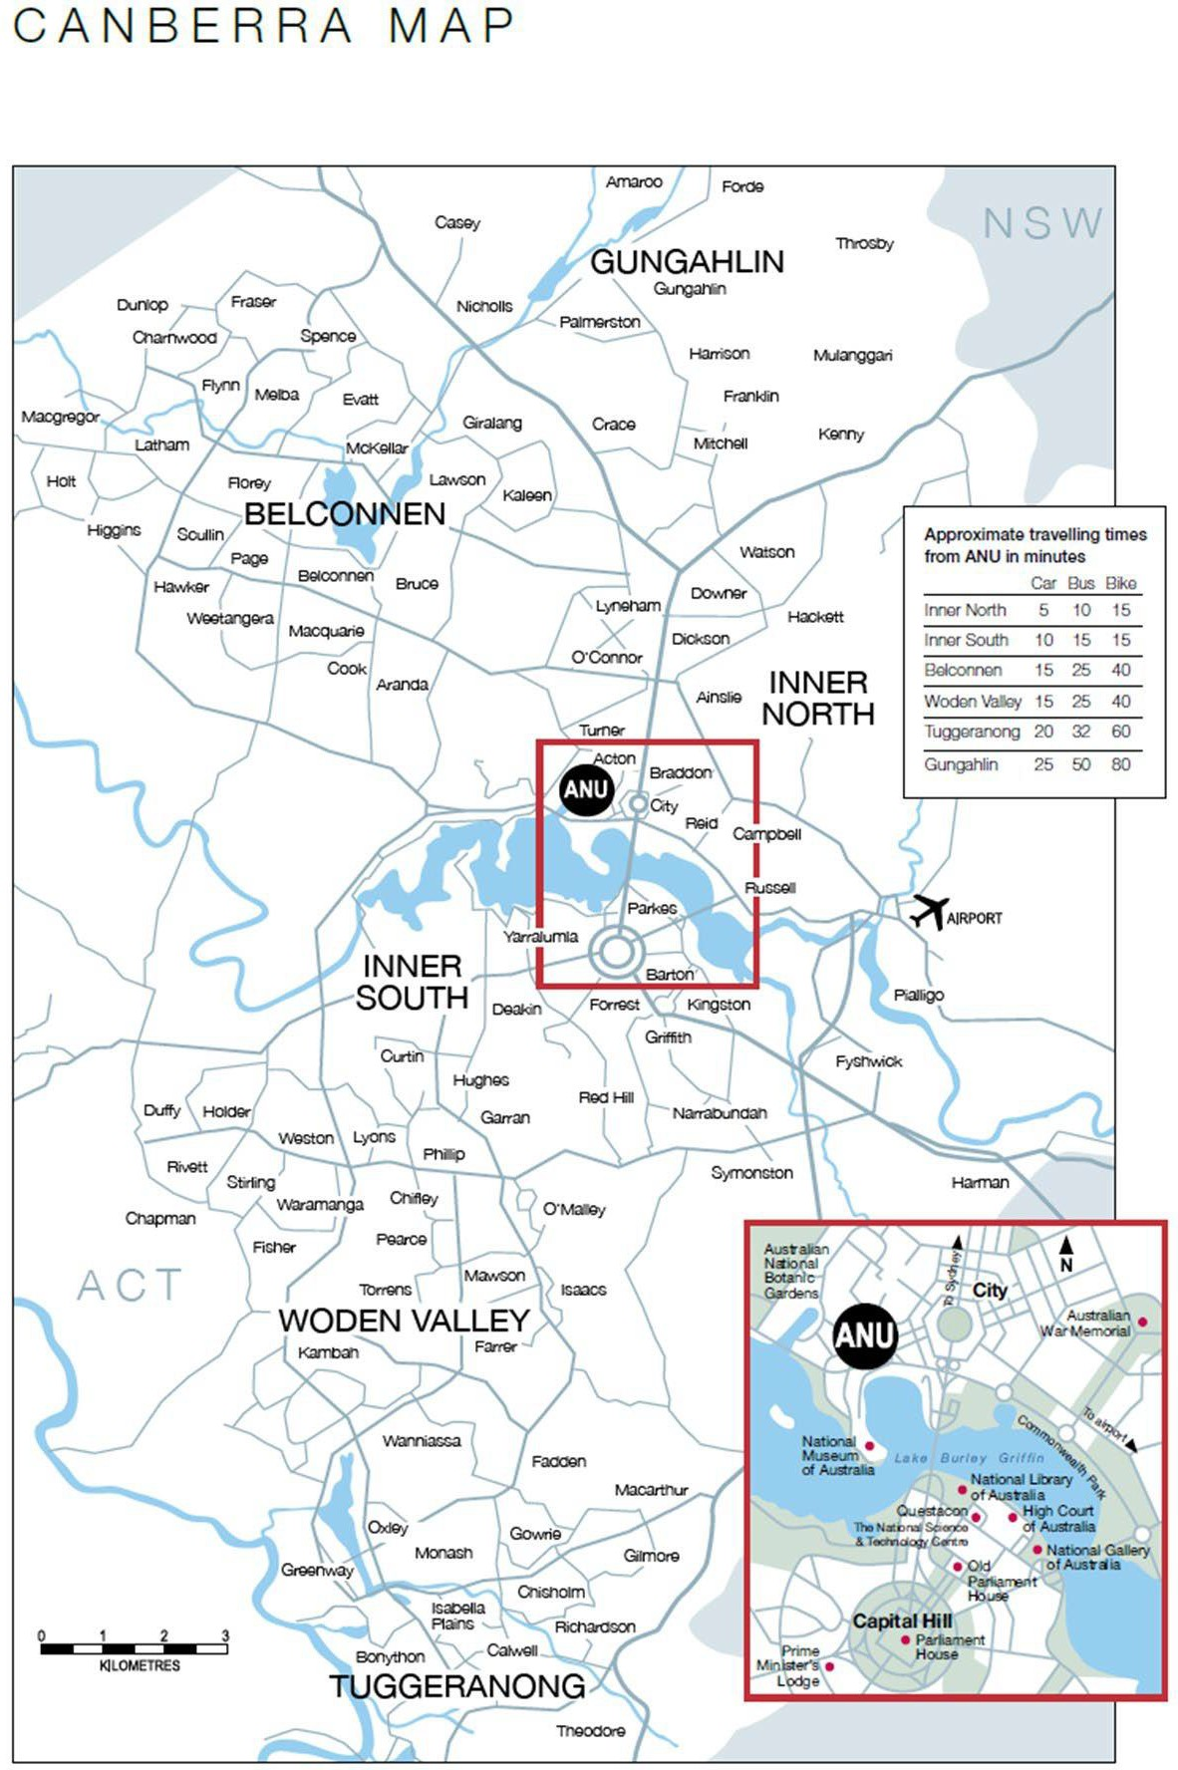
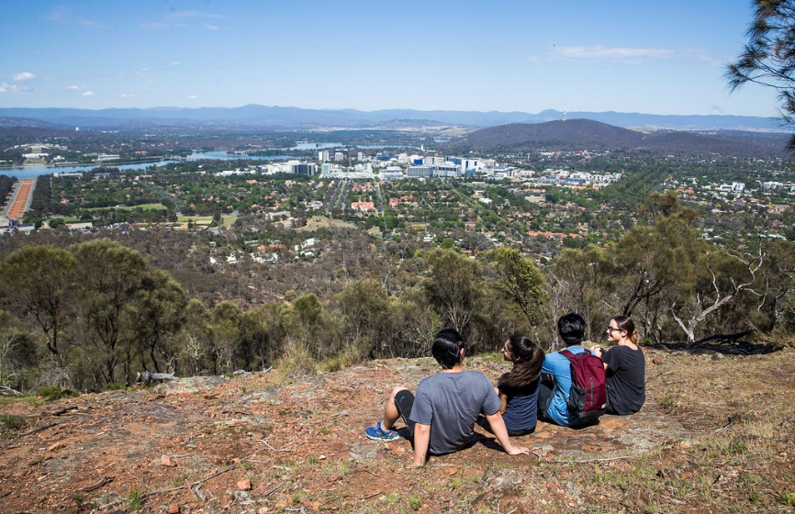
  Canberra Map
TEQSA Provider ID: PRV12002 (Australian University)

Slide 14

Cost of Living in Canberra
  Canberra is an expensive city, it is very important students are aware of the cost of living while studying, lest they find themselves in financial difficulty. It is also important to be aware that ANU has very limited financial assistance schemes available to students if financial difficulty does arise.
  As a general guide, we advise that single students should be prepared for the following living expenses. However, remember that every student has different needs and wants!
  Visit the ANU estimated cost of living page or Study Australia living costs website.
TEQSA Provider ID: PRV12002 (Australian University)

Slide 15

School Aged Children
All school aged children in the ACT, regardless of residential status (temporary or permanent), must enrol at the age-appropriate school level. Dependents who have been granted Dependent Visa’s do not have to pay tuition fees to attend Government schools up to and including year 12. However, schoolbooks, subject levies, uniforms and school outings must be paid for. Most schools will also expect you to pay a modest annual contribution. Dependents attending tertiary institutions are required to pay full tuition fees.
After you arrive, the AAS Teams can contact the ACT Department of Education and Training on your behalf to make the arrangements for your children to be able to attend an ACT Government School. A list of ACT Government schools is available here.
This is a two-step process that needs to be done through our offices.
    We request a tuition fee waiver letter for your children. This needs to be included when you apply for their dependent visas.
    Once your children have arrived in Australia, we request your children be allocated and enrolled into a local school.
  Important Notes:
    You will not be allocated a school until you have a permanent address. Proof of this is required.
    You do not get to choose which school your children are allocated. This is based on your address and the capacity levels of local schools in that area.
  English Language Requirements
  There is no requirement for international students to be proficient in English language when they enrol in ACT schools. To make the transition to the ACT School system as smooth as possible for international students with little or no English, two options are available:
    Introductory English Centres (IEC) at both primary and secondary levels prior to entry into mainstream schools.
    English language bridging programs in which students are taught English in short and intensive language classes while also studying mainstream subjects with Australian students.
  These programs develop students’ English language skills in reading, writing, speaking and listening. They teach specific study skills such as note taking, summarising, library skills, and report writing. Information technology skills are also developed.
  For more information visit the ACT Government website dedicated to International Students.
NSW Schools (those living in Queanbeyan)
The information provided above is for ACT schools only. If you plan to live in NSW (Queanbeyan area), you will need to see the application procedures and further information at the following website here.
TEQSA Provider ID: PRV12002 (Australian University)

Slide 16
Life at ANU
YOU’LL LOVE AUSTRALIA'S CAPITAL CITY
Life at ANU offers something for everyone. You can join in activities, including clubs and societies that complement your studies and future career, or ones that inspire you to pursue the things you love.
Getting involved in as many things as possible can help make sure your ANU experience is one of life’s best. Our campus is a hub of student activities, markets, performances, and more – many of which are held at Kambri and in easy reach of lecture halls and libraries. Canberra’s CBD is also just a short walk from campus.
Study Spaces
There are lots of spots all over campus to study, from lounge zones, cascading lawns and rooms with comfortable furniture, whiteboards and screens. Perfect for working on group projects.
Events
Kambri is the heart of our campus and is famous for all kinds of social events, from concerts to movie nights, theatre performances and DJ workshops. During Orientation week, it comes alive with markets and workshops. Find out more about events in Kambri.
Shops and Cafes
Our campus is crammed full of cafes, shops and bars that serve up study supplies and food from around the world. Catch up with friends over a burger, sushi, pub lunch or for a coffee fix.
Clubs and Societies
Joining a club or society is super easy and a great way to meet heaps of new friends, build networks and gain experiences that can help you grow and get the most out of university life.
Learn more about clubs and societies.
Students’ Associations
ANUSA is the representative body for all undergraduate students at ANU. If you are starting at ANU as an ANU Student, you are automatically a member of ANUSA. ANUSA focuses on welfare, advocacy, and social life for students. They run social events during O Week and throughout the year.
Young, vibrant and safe, Canberra is one of Australia's best kept secrets! Nestled between mountains and coast, the capital is rich in fresh air, culture and fun and ranks among the top 25 Best Student Cities in the world.
Culture capital
Canberra is filled to the brim with cultural institutions, so if you are interested in history or passionate about the arts, there is plenty here for you – think of the National Gallery of Australia and of its important national, Indigenous and international masterpieces or the National Museum of Australia and the Australian War Memorial. All these places can take you on a journey through Australian and world history and culture and inspire you to reflect on your place in the world.
Fabulous food
The city’s thriving coffee culture and award-winning restaurants will impress you. You’ll find Canberra’s a place for foodies, whatever your budget. Students make up a quarter of the city’s population, so you will find plenty of festivals, bars and music venues to go to as well.
Natural wonders
With four distinct seasons and nature in abundance, Canberra is the perfect place for adventure seekers year-round. You can ride a bike or paddle a kayak around Lake Burley Griffin or hike through the sprawling Namadgi National Park and Tidbinbilla Nature Reserve. For a dose of studying or relaxation with music or a movie, you can wander over with friends to the Australian National Botanic Gardens, which is next door to the ANU campus.
Easy commuting
The capital city's great roads, convenient light rail and bus routes mean you won’t ever be far away from campus or the CBD. Choose to live in student accommodation on campus, and everything you'll need, including your classes, will be just a short walk or bike ride away.
TEQSA Provider ID: PRV12002 (Australian University)

Slide 17
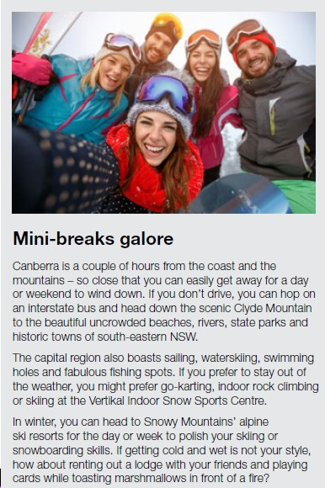
ANU Facts
#34 university in the world¹
#5 stars for student-to-staff ratio and staff qualifications in Australia²
#1 most international university in Australia³
#1 most employable graduates in Australia⁴
Top 10 in the world in six disciplines ³
#1 in 13 academic disciplines in Australia⁵
Only Australian member of the International Alliance of Research Universities (IARU)
#1 most sustainable city in Australia ⁶
#3 smartest city in the world ⁷
25% of people speak a language other than English ⁸
3 hours’ drive to Sydney
2 hours’ drive to the snow and the sea
Short commute times by car, tram or bicycle
1. QS World University Rankings 2023; 2. Good Universities Guide 2023; 3. Times Higher Education Rankings 2023; 4. Times Higher Education Global University Employability Rankings 2023–24; 5. QS World University Rankings by Subject 2023; 6. The World’s Most Sustainable Cities 2021; 7. IMD Smart City Index 2023; 8. Multicultural Canberra 2022;
Climate
One of the best aspects of living in Canberra is our four distinct seasons:
  Warm, dry summers with an average temperature of 27 degrees.
  Autumn is stunning and we celebrate with big outdoor festivals and hot air balloons.
  Winter’s average temperature is 12 degrees, with crisp days and nights get very cold!
  Spring is all about flower festivals and getting outside to the parks and open spaces.
  Useful Resources
Prepare for Academic Life
Get ready for your study program: https://programsandcourses.anu.edu.au/
Check your class and exam timetables: https://www.anu.edu.au/students/program-administration/timetabling
Everything you need to know about academic honesty and plagiarism at ANU: https://www.anu.edu.au/students/academic-skills/academic-integrity
Seek help for disability and access issues: https://www.anu.edu.au/students/contacts/accessibility
Get free and confidential academic help: https://www.anu.edu.au/students/academic-skills
Make the most of our IT services – email, printing, and free software etc.: http://itservices.anu.edu.au/
Check out the Information Literacy Program for all students: https://anulib.anu.edu.au/research-learn
Find out what study resources and facilities the ANU Library offers: https://anulib.anu.edu.au/
Make the Most of Student Life
Access services and join student clubs and societies at the ANU Students’ Association: https://anusa.com.au/
Join the ANU gym and sport & fitness activities: http://www.anu-sport.com.au/
Events on campus, including public lectures, seminars and exhibitions: https://www.anu.edu.au/students/student-life/events-stories
Campus Facilities and Services
ANU campus map: http://www.anu.edu.au/maps#
Find out more about campus facilities: https://www.anu.edu.au/about/campuses-facilities
TEQSA Provider ID: PRV12002 (Australian University)

Slide 18
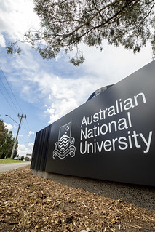
Academic Colleges
ANU College of Arts and Social Science (CASS): https://cass.anu.edu.au/
ANU College of Asia & the Pacific (CAP): http://asiapacific.anu.edu.au/
ANU College of Business & Economics (CBE): https://www.cbe.anu.edu.au/
ANU College of Engineering & Computing and Cybernetics: https://cecc.anu.edu.au/
ANU College of Law: https://law.anu.edu.au/
ANU College of Health & Medicine (CHM): https://health.anu.edu.au/
ANU College of Science (CoS) http://science.anu.edu.au/
Health and Wellbeing
See a doctor at the ANU Health Service: https://www.anu.edu.au/students/contacts/medical-services
Get free and confidential wellbeing support: https://www.anu.edu.au/students/health-safety-wellbeing
Find religious support and services for all faiths: https://www.anu.edu.au/students/contacts/chaplaincy
Find support for Muslim students: https://anusa.com.au/life/club/msaanu/
Support for gay, lesbian, bisexual, transgender, intersex and queer students: https://anusa.com.au/advocacy/queer-collective/
Emergency and Safety
Download the ANU OK app: https://services.anu.edu.au/campus-environment/safety-security/anuok-app
Find out more about safety and security on campus: https://services.anu.edu.au/campus-environment/safety-security
In case of emergency on Campus: https://services.anu.edu.au/campus-environment/safety-security/emergencies-on-campus
Emergency + Smartphone App: https://www.emergencyplus.com.au/
Life in Canberra
Visit Canberra website to find out things to do and major events in Canberra: http://visitcanberra.com.au/
Access Canberra the ACT Government Information Portal to find out information about ACT services: https://www.accesscanberra.act.gov.au
The International Student Guide to Australia: https://insiderguides.com.au/destination/studying-in-canberra/
Dining Options Guide- Halal: https://www.agfg.com.au/restaurants/halal-category
Produced by Central Australia Awards Team
ANU reserves the right to vary the material, information or publication of this guide without notice.
TEQSA Provider ID: PRV12002 (Australian University)

